Slide 1

WIPRO NGA PROGRAM – C++ Programming | | Linux System Programming batch
Capstone Project Presentation – 12 August 2024
Project Title – Online Library Management System
Presented by – Divya Dharshini.V

Slide 2
Overview:
Introduction
This project is an online library management system implemented using a server-client architecture in C. The server handles multiple clients concurrently through multithreading. Each client can perform actions such as borrowing or returning books. The system ensures that only available books can be borrowed, and it handles book availability and client details efficiently.

Slide 3
Objectives
The objective of the Multithreaded Online Library Management System is to efficiently manage book borrowing and returning processes by enabling multiple clients to interact with the system simultaneously, ensuring real-time updates on book availability, and maintaining data integrity through secure and scalable multithreaded server architecture.

Slide 4
Motivation
In today’s fast-paced digital world, the need for efficient and automated library management systems is crucial. Traditional library systems often require manual operations, which can be time-consuming and prone to errors. The motivation behind this project is to develop a robust and scalable library management system that allows multiple clients to interact with the system simultaneously, ensuring a seamless borrowing and returning process. The multithreaded architecture ensures that the system can handle concurrent client requests without performance degradation, making it suitable for modern libraries with heavy traffic.

Slide 5
Scope
This project aims to build a server-client library management system with the following features:-
Client Registration: Clients can register their details (name, address, and phone number) when they connect to the system.
Book Borrowing: Clients can borrow books by entering the book title. The system checks the availability and allows borrowing for up to 7 days.
Book Returning: Clients can return borrowed books by entering the book ID, making the book available for others.

Slide 6
Scope
Multi-client Support: The system can handle up to 10 clients concurrently, allowing multiple clients to borrow and return books simultaneously.
Real-time Updates: The server updates the availability of books in real-time and informs clients about the status of their requests.
Security: The system ensures that each client can only borrow or return their books, preventing unauthorized actions.

Slide 7
System Design
Architecture
The system is built on a client-server architecture:
Server: Manages client connections, processes book borrowing and returning requests, tracks overdue books, and handles client information.
Client: Allows users to query book availability, borrow books, return books, and view their borrowed books list.

Slide 8
System Design
Components.
Server (server.c): Manages client connections, book queries, and tracks the borrowing and returning of books using threads.
Client (client.c): Provides an interface for clients to interact with the library, including querying book availability and managing their borrowings.

Slide 9
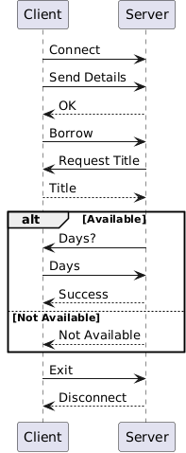
System flow

Slide 10
Application Tools Used
Programming Language: C Language:The project is implemented in C, a powerful language that provides control over system resources and is commonly used for system-level programming.
Development Tools: GCC Compiler on a Linux environment.
Version Control: Git for source code management.
Text Editor/IDE: Vim/VS Code for code development.

Slide 11
Modules
Server Module
Connection Handling: Manages client connections, including accepting new connections and spawning threads for each client.
Book Management: Handles requests for querying, borrowing, and returning books.
Client Management: Tracks client information, including personal details and borrowed books.

Slide 12
Module
Client Module
User Interface: Provides a text-based interface for interacting with the server.
Book Operations: Allows clients to query book availability, borrow, and return books.
Client Information Handling: Collects and sends client details to the server, and displays borrowed books.

Slide 13
Compilation and Execution
Compilation
Server: Compile with threading support.
gcc -o server server.c -lpthread
Client: Compile without additional libraries.
gcc -o client client.c
Execution
1. Start the Server: /server
2. Run the Client:/client

Slide 14
Testing and Validation
Test Scenarios:
Multiple Clients Borrowing Different Books: Verify that multiple clients can borrow different books simultaneously and that book availability updates correctly.
Borrowing Unavailable Books: Ensure the server correctly informs clients when a book is not available.
Returning Books:Test that returning a book updates the availability and allows other clients to borrow it.
Expected Outcomes:
Books should not be borrowable if they are already borrowed.
Once a book is returned, it should be available for other clients to borrow.

Slide 15
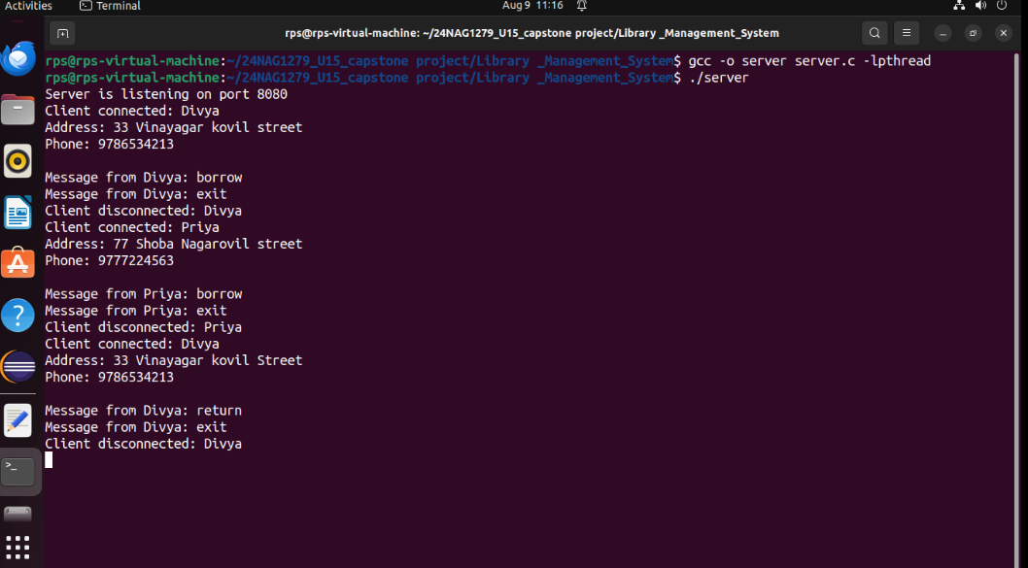
Output Screenshots - server

Slide 16
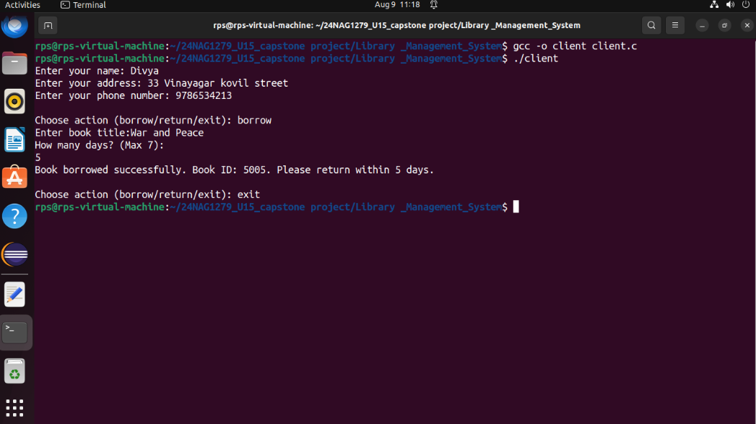
Ouput Screenshot – client 1

Slide 17
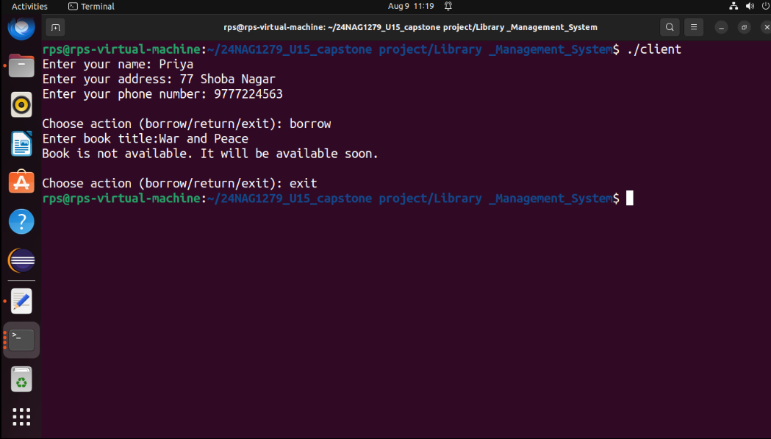
Output Screenshot – Client 2

Slide 18
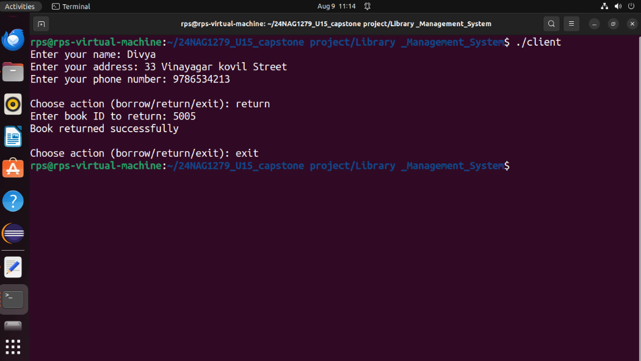
Output Screenshot – client 3

Slide 19
Advantages
Concurrent Handling:Supports multiple clients simultaneously for efficient operations.
Real-Time Updates: Instant book availability updates prevent errors.
Scalability: Easily adapts to growing library needs.
User-Friendly: Simple interface for all users.
Automation: Reduces manual work and human errors.
Security: Protects against unauthorized access.
Customizable Borrowing: Flexible borrowing periods within limits.

Slide 20
Future Enhancement
Client Authentication: Implement user login functionality to keep track of user borrowing history.
Graphical User Interface: Develop a GUI for the client application to make the system more user-friendly.
Notification System: Implement a system to notify clients when borrowed books are due.

Slide 21
Conclusion
The Multithreaded Online Library Management System provides a robust implementation of a client-server architecture for managing book borrowings and returns. It efficiently handles multiple clients using multithreading, ensuring smooth and concurrent interactions. The system serves as a solid foundation for further development, including database integration, enhanced user interfaces, and improved security measures.

Slide 22
Thankyou

